Slide 1

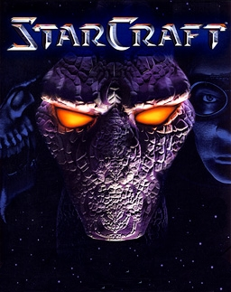
StarCraft Player Data
(Modeling and Data Viz)
Ashraf Mogal
May 25th, 2023

Slide 2

Context

Slide 3
The project goal is to…
“Determine the predicted rank for each player based on the historical information”

Slide 4

Data

Slide 5
Summary of the Data Variables
Demographic
Information
Historical Information
Outcome Variables
LeagueIndex
Age
HoursPerWeek
TotalHours
APM
SelectByHotkeys
AssignToHotkeys

Slide 6

Exploratory Data Analysis

Slide 7
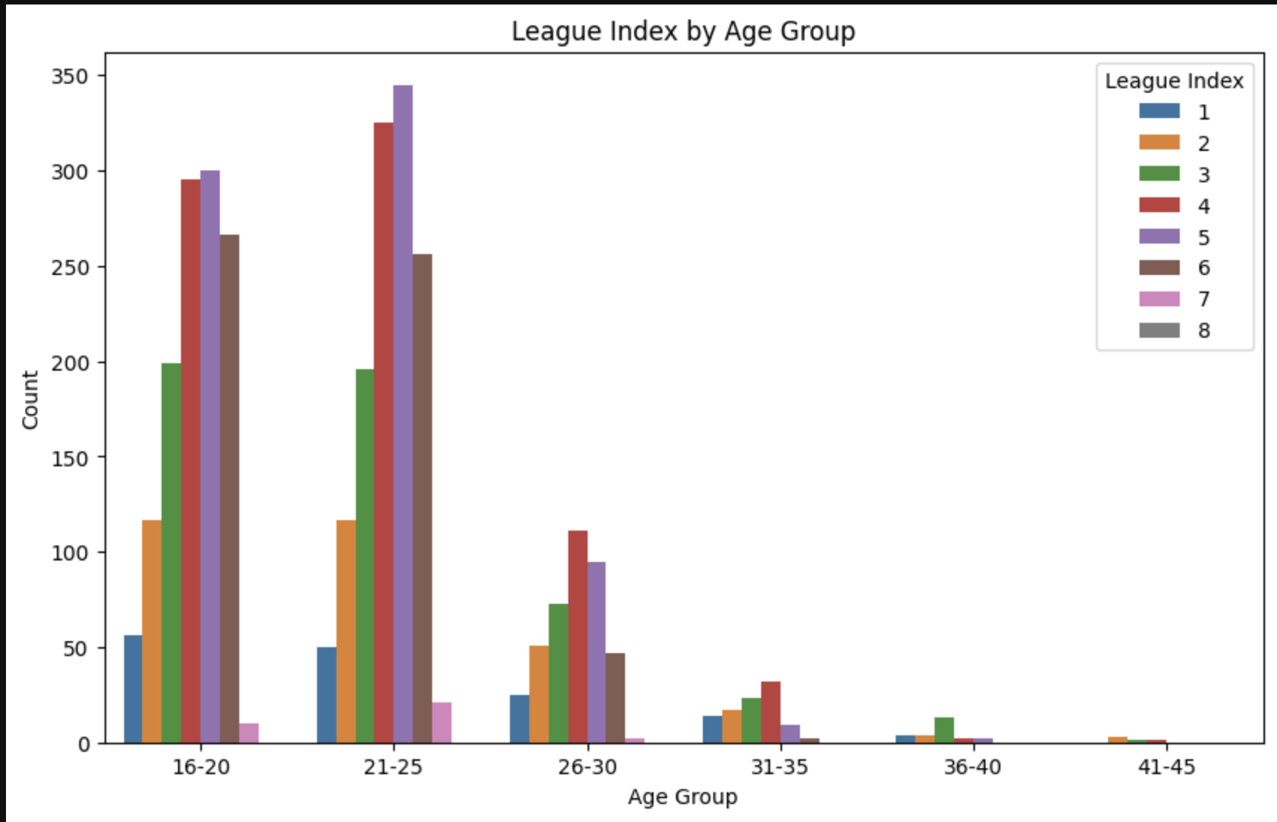
League Index by Age Group
Highlights
We can see that most of the players are in the age group of 16-25
Players with highest ranks are in the age group of 21-25
Players with lowest ranks are in the age group of 36-45

Slide 8
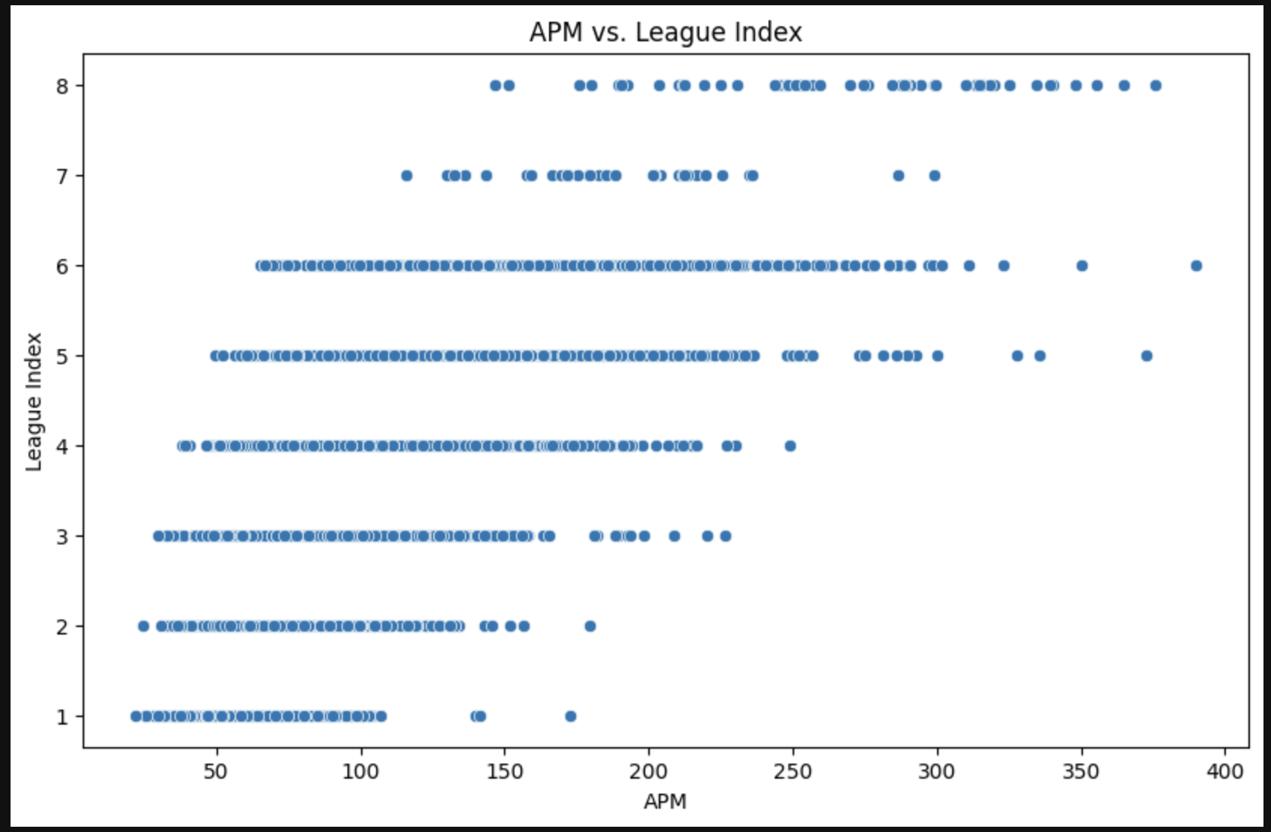
APM vs League Index
Highlights
As the APM increases the league index increases and there are very few outliers in the data
The players with highest league index are having APM between 150-300
The players with lowest league index are having APM between 0-150

Slide 9
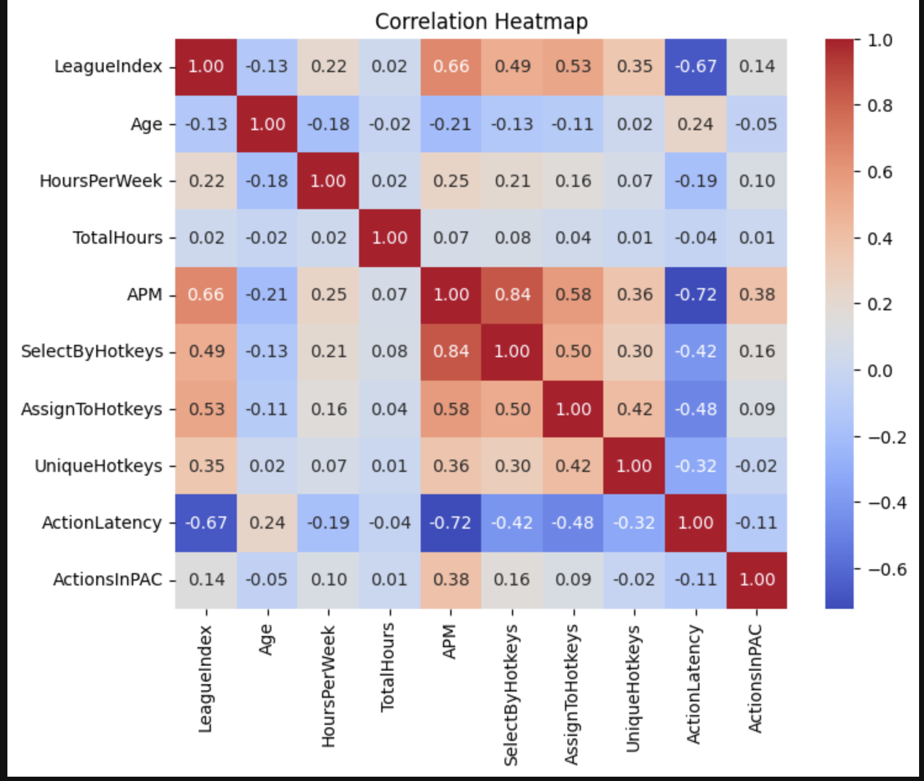
Correlation matrix
Highlights
- There is a high positive correlation between League Index and Total Hours, APM, Select By Hotkeys, Assign Hotkeys. If a player is having high rank, they are having high APM, Select By Hotkeys, assign hotkeys or vice versa
The APM is also highly correlated with Select By Hotkeys, assign hotkeys.
We could see that the Action Latency is having a negative correlation which makes sense as latency increases the higher chances the player might lose a game.

Slide 10

Model Building and Evaluation

Slide 11

Different models applied
I have used the Logistic Regression model with interactions and without interactions. Since we have correlation between the variables the logistic regression with interactions had better accuracy.
I have also applied Neural Network model using hyperparameter training to choose the best hidden layers.
I have used Random Forest classification model and applied which is the best set of features that we can use for the model.

Slide 12
Best Model highlights
We can conclude that the Random Forest classification model is the best as it gives us the best model evaluation metrics
MSE: 0.84
MAE: 0.73
R2 score: 0.62
RF model also concluded that the top 5 features for model building are APM, Action Latency, Total Hours, Assign To Hotkeys and Minimap Attacks.

Slide 13

Strategy and Recommendations

Slide 14

Guidance for Stakeholders
Key Areas to Focus on: Age, APM, Action Latency, League Index
Maintain Focus on Existing Features: Total hours, assign to hotkey, and select by hotkey, which have shown significant correlations with the league index.
Explore Other Potential Features: For example, factors like game-specific strategies, in-game resources, or player feedback could be collected to gain further insights into rank determination
Regular Model Evaluation and Iteration: Continuously evaluating the model's performance and incorporating new data can ensure that the model remains up-to-date and relevant to the evolving dynamics of the game and player behaviors.

Slide 15
Thank you!

